Slide 1

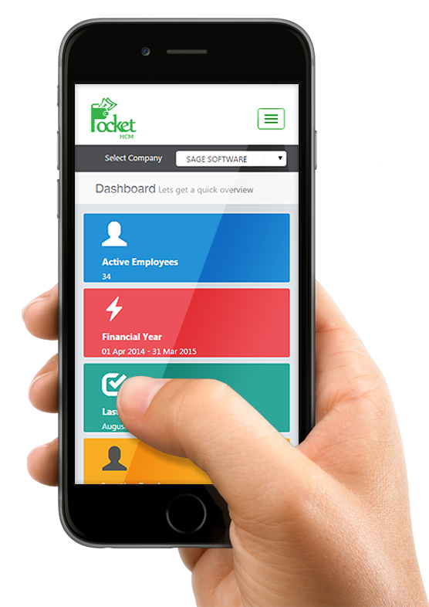
How to Develop first Laravel WISS – Web Interactive Self-Service Aisin Asia Pacific
WISS
20 Feb 2022
Traitet Th. Line @traitet

Slide 2
Manual to develop web report
5 Mar 2022

Slide 3
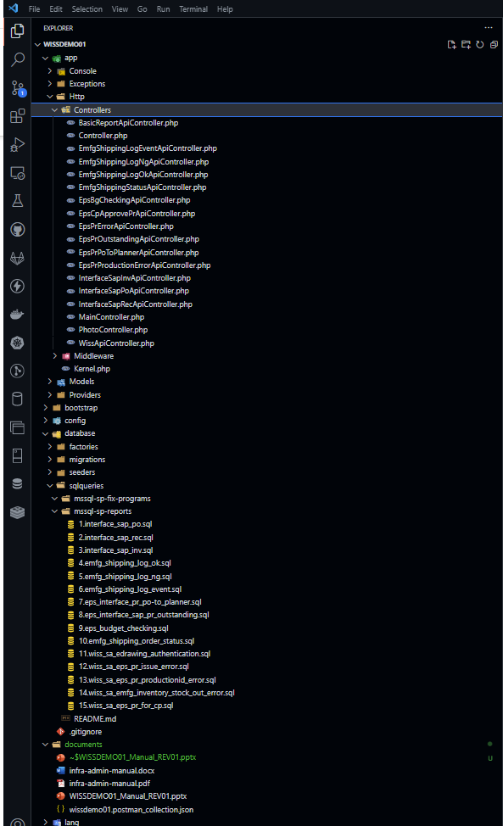
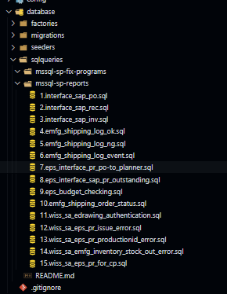
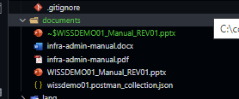
Folder Structure
Controller
Document
1. WISSDEMO01_Manual : how to develop api, frontend, sql
2. wissdemo01.postman.collection: json for import to postman for testing
SQL (Store procedure)
SQL (Store procedure)

Slide 4
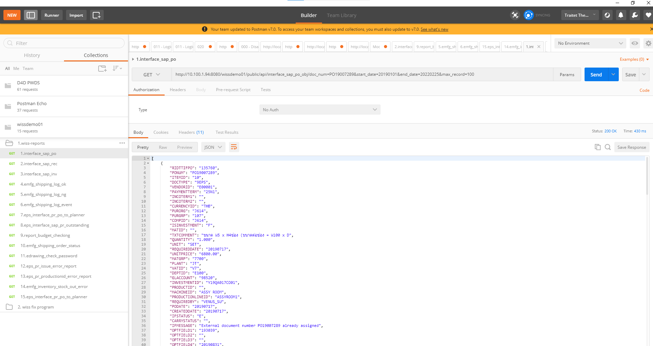
How to test Json on postman
Import wissdemo01.postman.collection.json to Postman
Select api for testing
Change to Json (Easy to read)
1
2
3

Slide 5
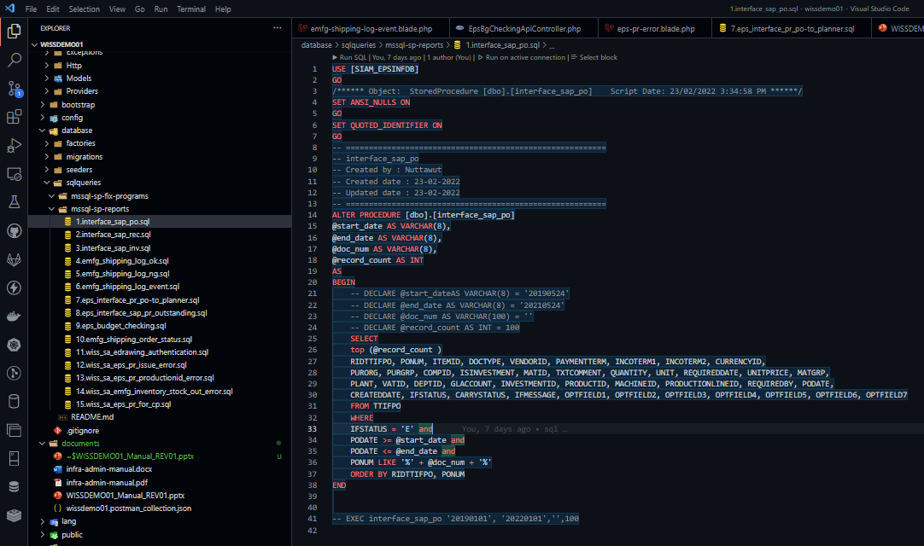
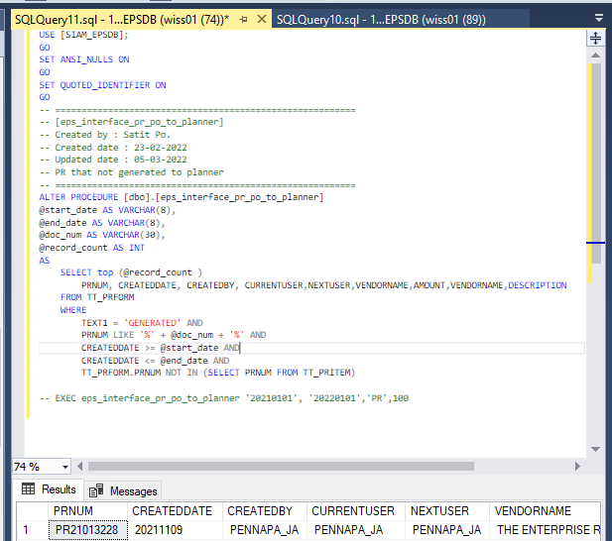
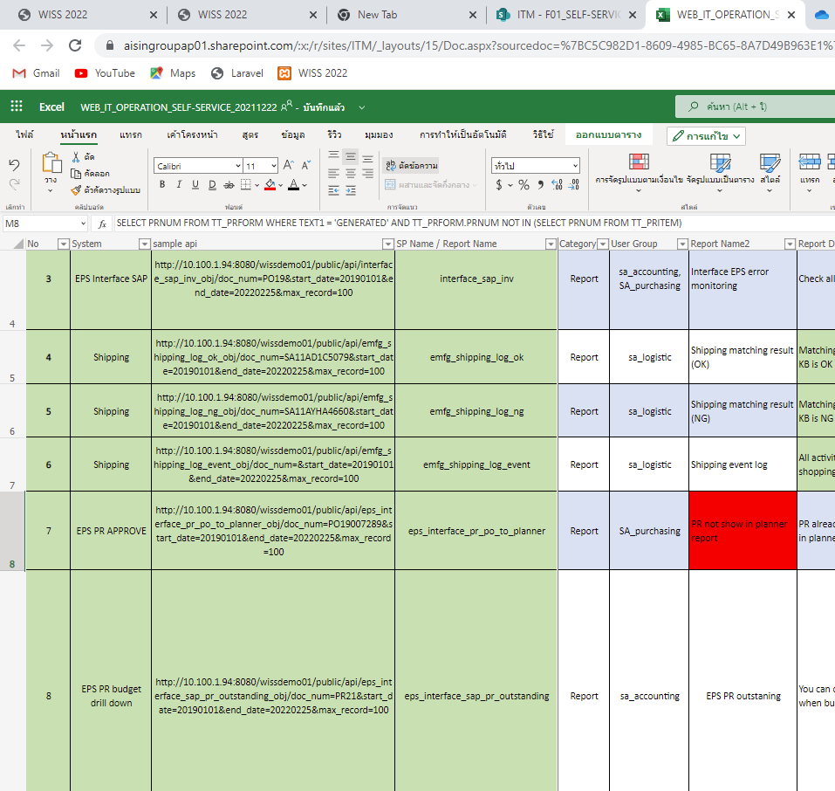
Step to dev for Store Procedure
Read and Update spec in Excel Online: WEB_IT_OPERATION_SELF-SERVICE_20211222.xlsx
Make SQL file e.g., database/sqlqueries/mssql-sp-report
Create Store procedure on SQL Management studio
Test on SQL Management studio
Push code to git
Note.
Put sample code in bottom
Basic Parameters are start_date, end_date, doc_num, and record_count
3
2
A
1
B
4

Slide 6
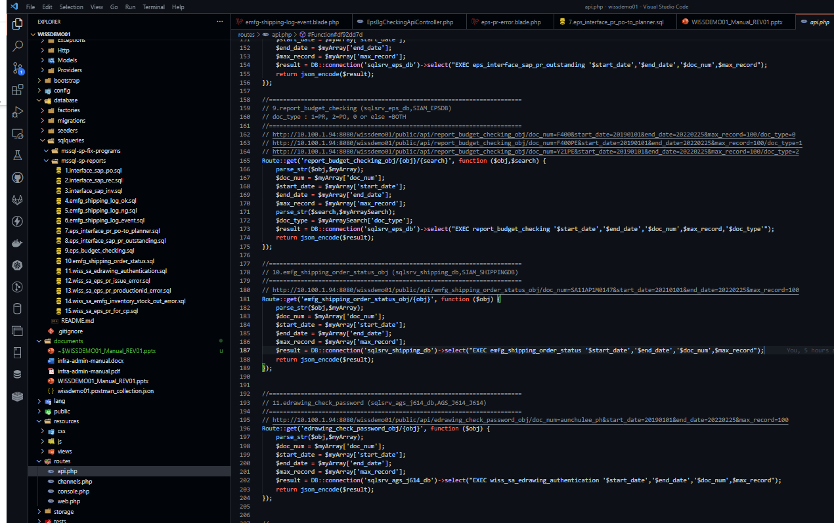
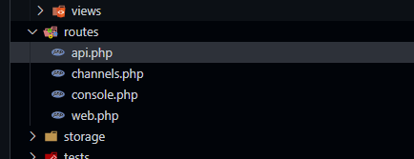
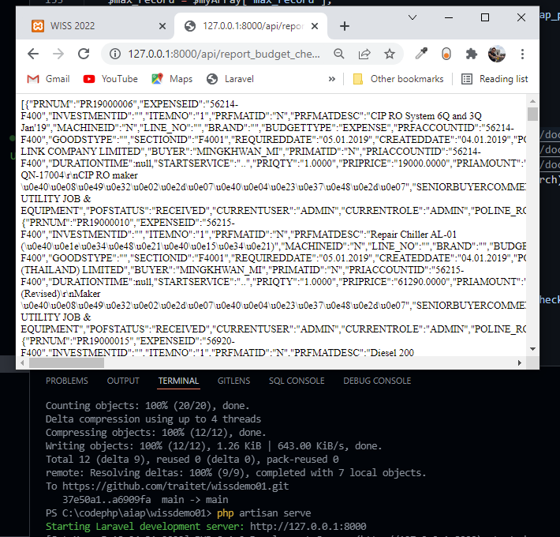
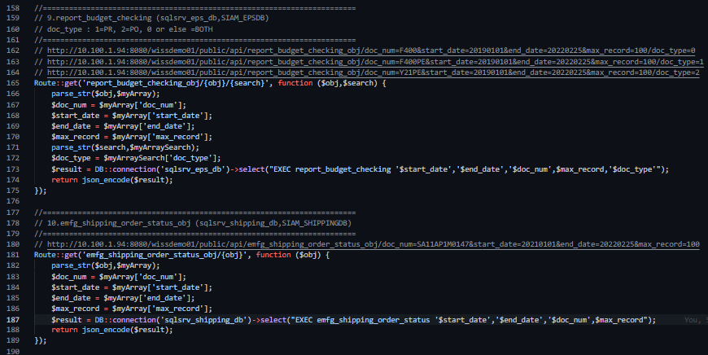
How to dev api for Basic Report?
Prerequisite
Pull git as last version
Open routes/api.php
SQL Server Driver on php (copy drive to etc, edit config.php )
How to code ?
Store procedure name (DATABASE)
Sample api URL (need to deploy to web server to run but you can run on URL Fill parameters
Call store procedure and return json result
Run php artisan service
Test on URL e.g. http://127.0.0.1:8000/api/report_budget_checking_obj/doc_num=F400&start_date=20190101&end_date=20220225&max_record=100/doc_type=0
6
1
5
2
3
4

Slide 7
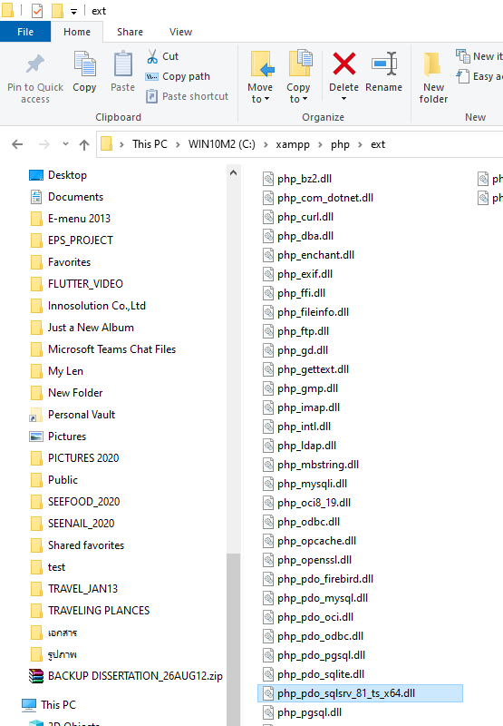
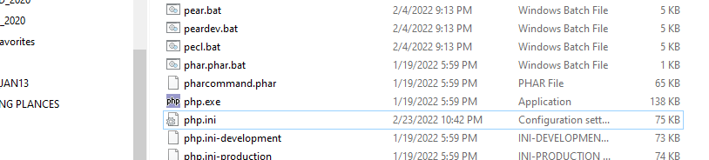
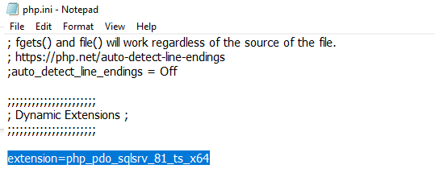
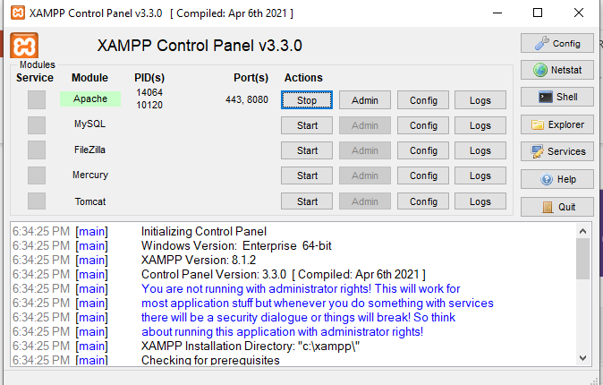
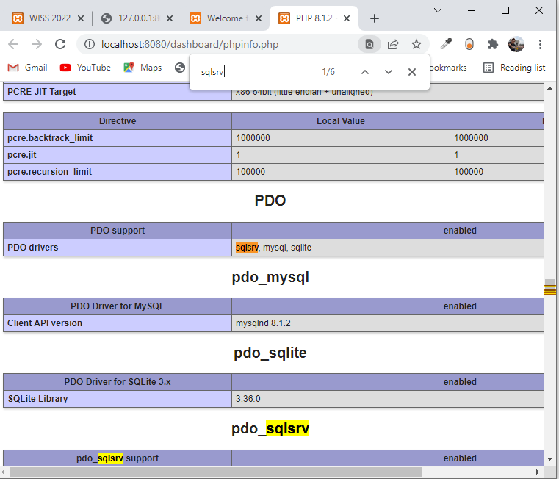
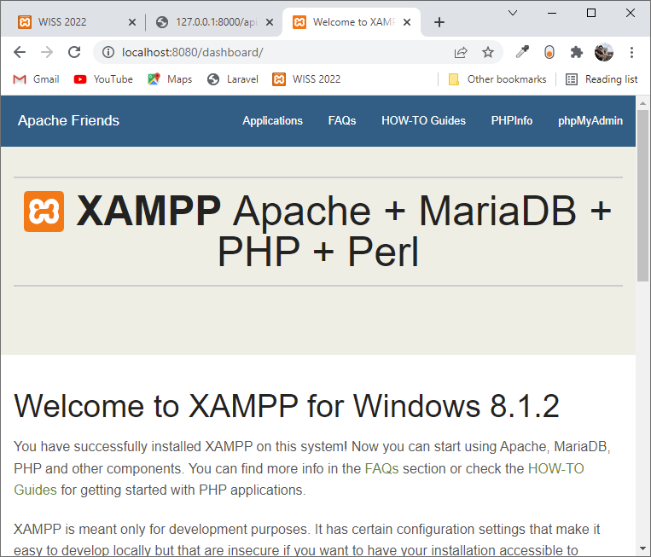
How to install Microsoft SQL Driver PHP
Steps
Download and put SQL driver file into ext folder e.g. xampp/php/ext/php_pdo_sqlsrv_81_ts_x64.dll (https://docs.microsoft.com/en-us/sql/connect/php/download-drivers-php-sql-server?view=sql-server-ver15)
Open php.ini file in path e.g. c:\xampp\php/php.ini
Find Dynamic Extensions and add line e.g. extension=php_pdo_sqlsrv_81_ts_x64
Start Apache, go to default page e.g. localhost or localhost:8080
If at pdo has sqlsrv, you success to install sql drive
2
3
5
1
4

Slide 8
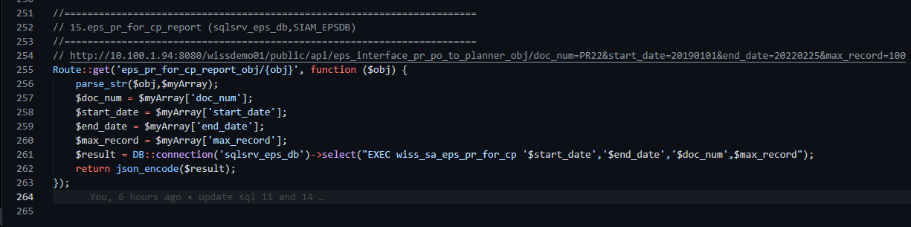
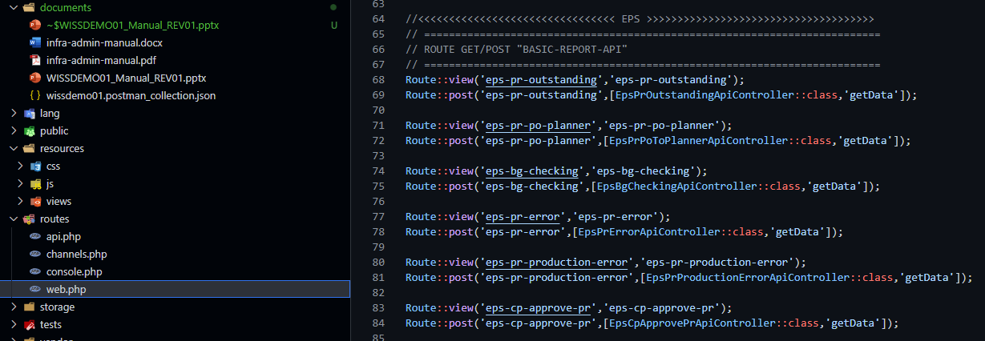
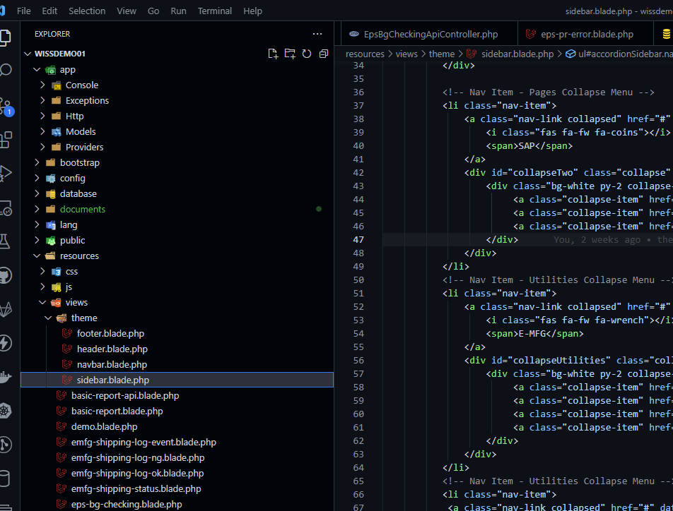
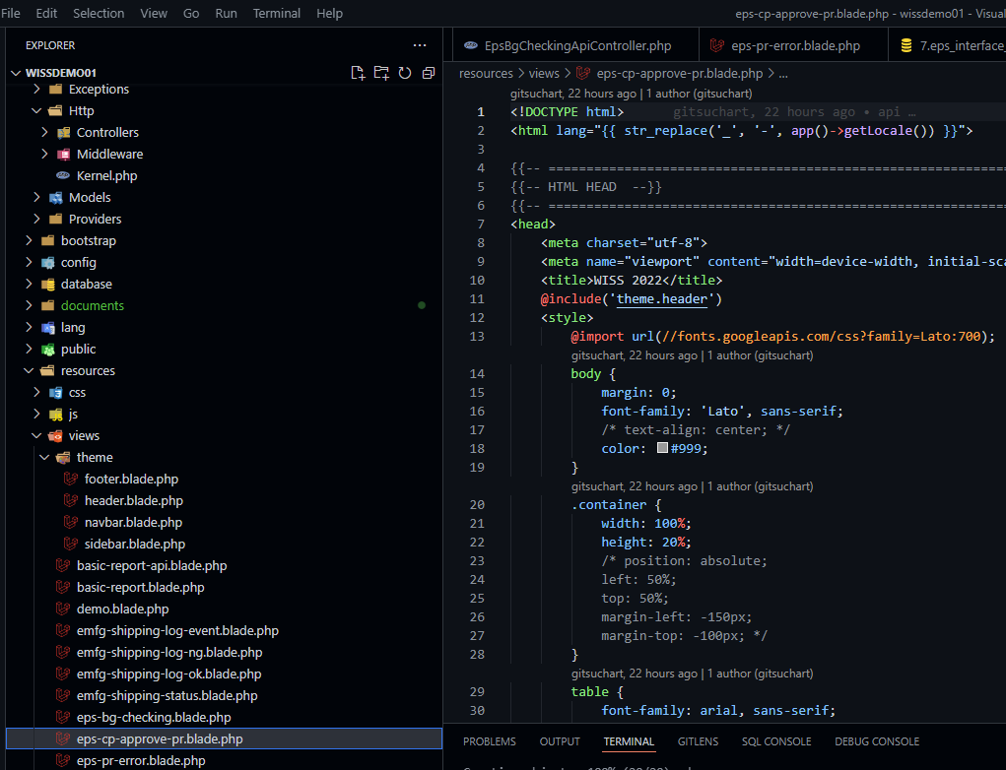
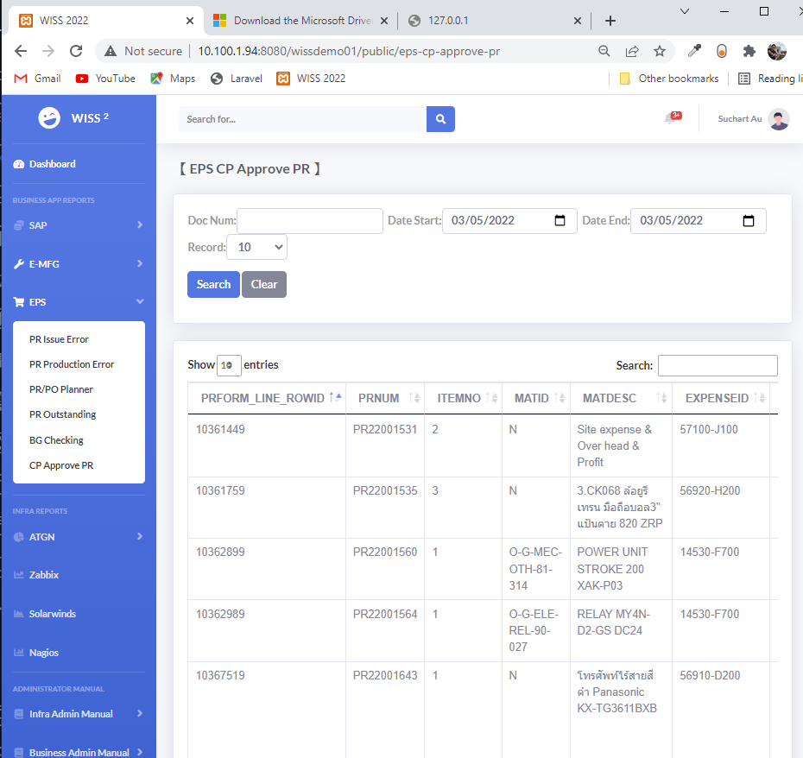
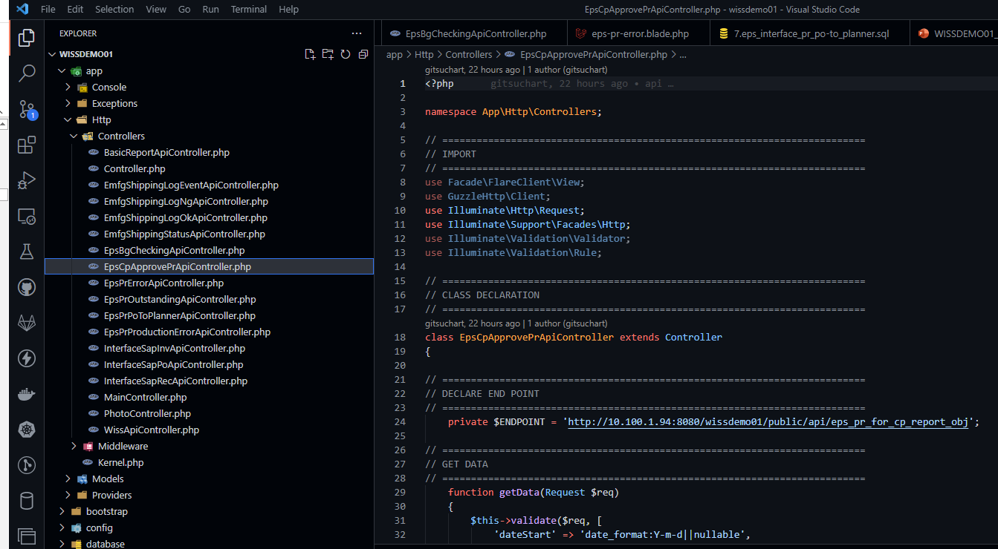
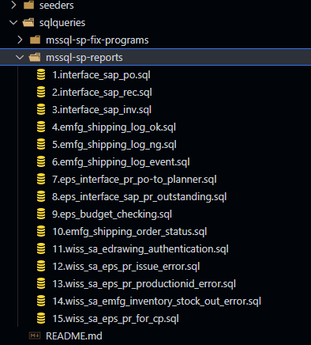
Basic step to code php front-end for web report
Steps
Add WEB API in view routes/api.php ** Need to deploy to server or you can run test locally e.g. http://127.0.0.1:8000/api/report_budget_checking_obj/doc_num=F400&start_date=20190101&end_date=20220225&max_record=100/doc_type=0
Add SIDEBAR Menu in resources/views/theme/sidebar
Add CONTROLLER file e.g. http/Controllers/EpsCpApprovePrApiController.php)
Add VIEW e.g. resources/views/eps-cp-approve-pr.blade
Run test, php artisan serve, go to URL e.g. http://127.0.0.1:8000
Note
1. You can see Store procedure spec at sqlqueries/mssql-sp-reports
1
5
2
5
3
4
A

Slide 9
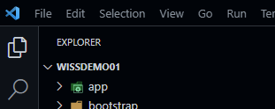
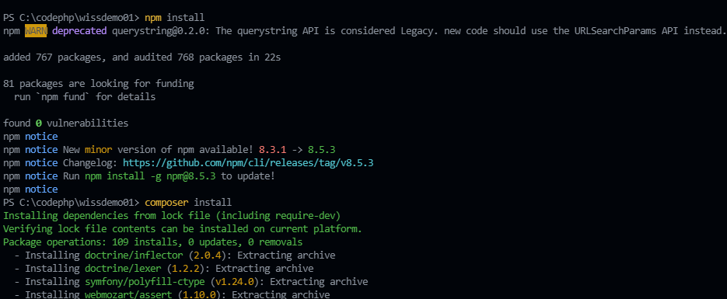
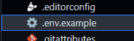
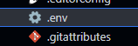
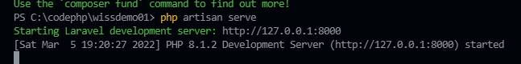
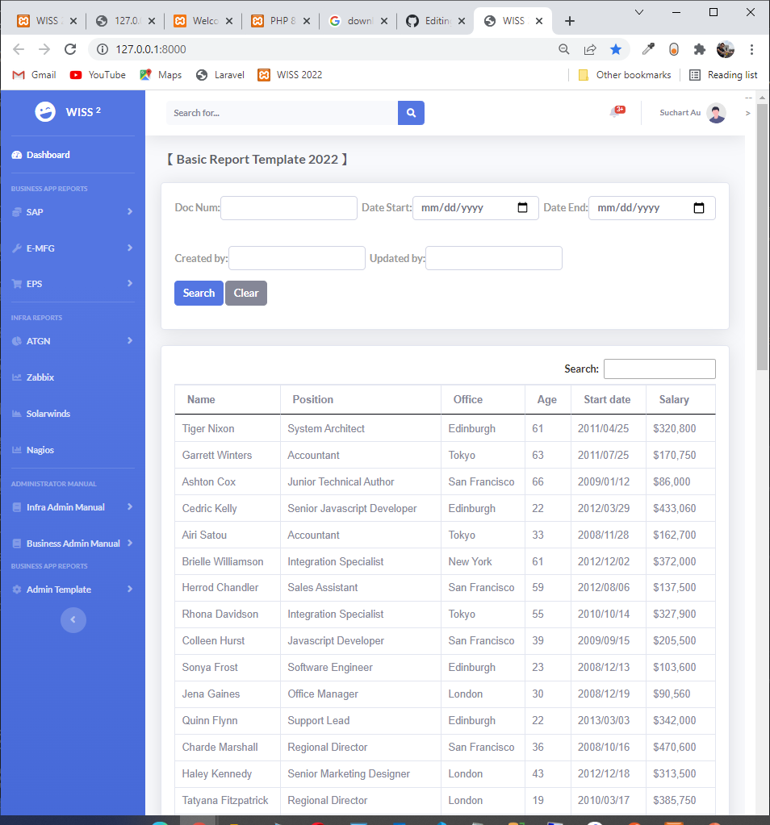
Git: 1st Download project and run
Steps | Code | Capture
Create folder in your PC | cd d:, md phpcode, cd phpcode
2. Run git clone | git clone https://github.com/traitet/wissdemo01.git
3. Open wissdemo01 in VSCode
4. Download Package | npm install composer install
5. Change .env.example file | Rename from .env.example to .env
6. Run php | php artisan serve
7. Open URL | http://127.0.0.1/8000

Slide 10
Get: Pull and push code to cloud
Steps | Code | Capture
1.Pull to get last version from cloud | Git pull
2. Edit code
3. Push code to cloud | Git add. Git commit –m “Upload doc manual” Git push

Slide 11
1. Create Project
No | Code | Code
1 | Create Laravel Project Open vscode and open folder wissdemo01 Required Install Composer 2.2.6 (Laravel) – download from internet Install Vscode and package related Laravel and php Install Last Xampp 8.1.2 (PHP 8) Set path in variable environment to open php, composer from any path in windows | composer create-project --prefer-dist laravel/laravel wissdemo01
2 | Create repo on github named “wissdemo01” Run command | commit for local git Run command | push to git cloud Required Register github Install git on windows | echo "# wissdemo01" >> README.md git init git add README.md git add . git commit -m "first commit" git branch -M main git remote add origin https:/github.com/traitet/wissdemo01.git git push -u origin main
3 | php artisan serve | php artisan serve
4 | Open URL e.g. http://10.100.1.94:8080

Slide 12
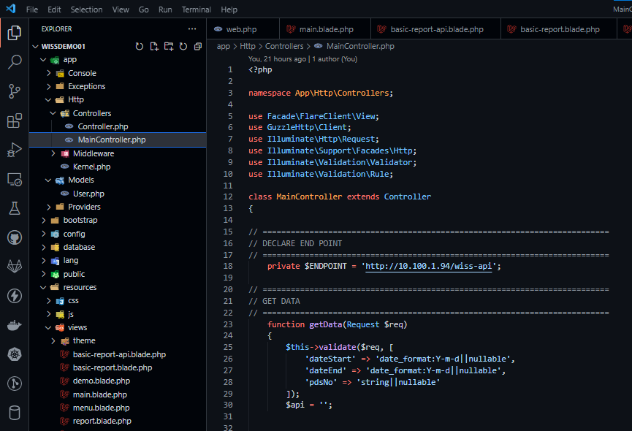
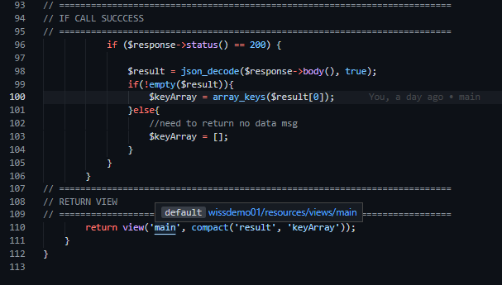
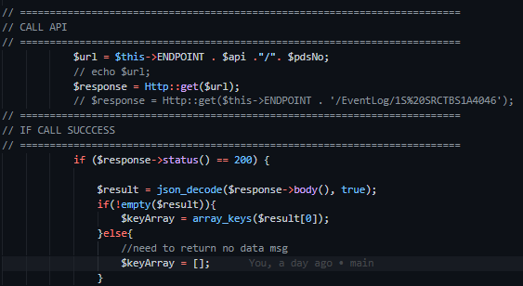
Code ตัวอย่าง | Main Controller
Import http
Return View
Validate data
Call API
If success

Slide 13
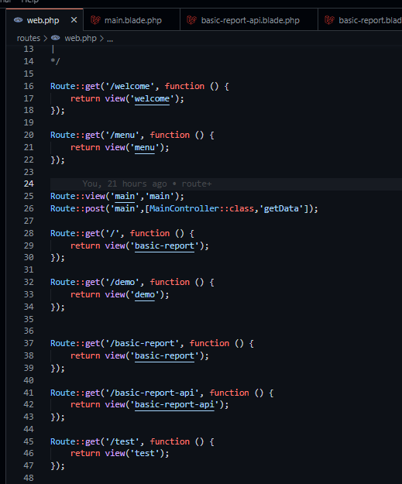
Routes | web.php
Get
1) Call [root path]/welcome e.g. 10.100.1.94/welcome
2) Show view webcome
Post → Call controller
Call getData
Return view (View = main.blade.php)

Slide 14
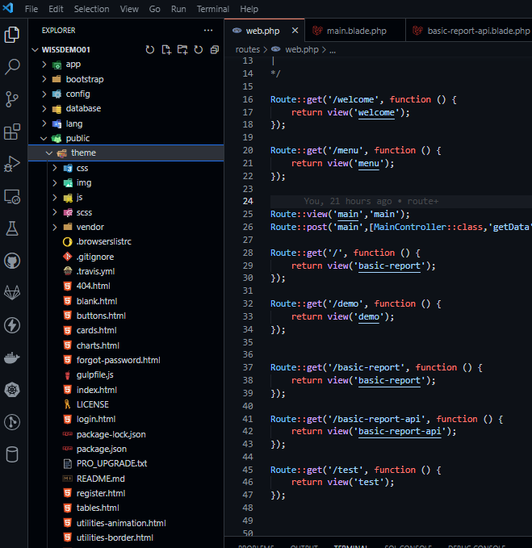
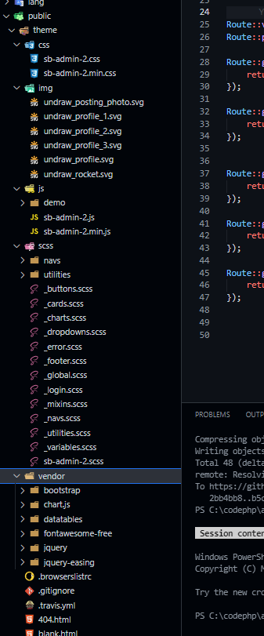
Theme SB
Can copy all for sample code

Slide 15
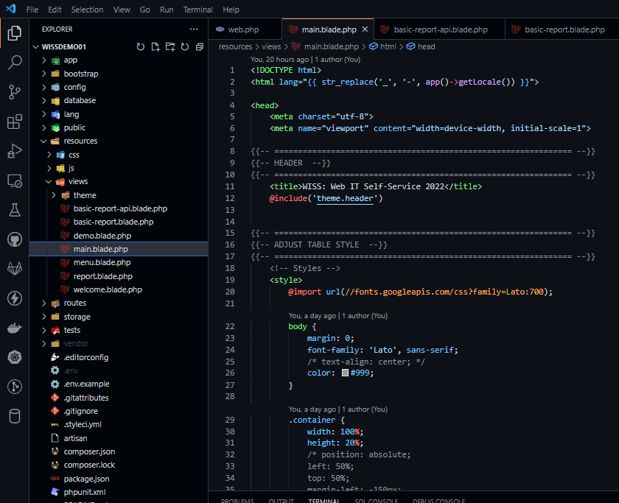
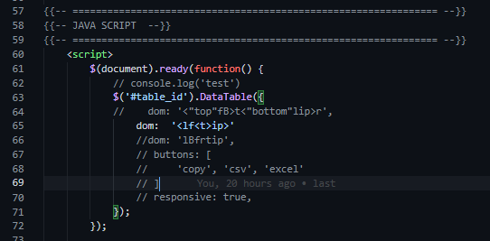
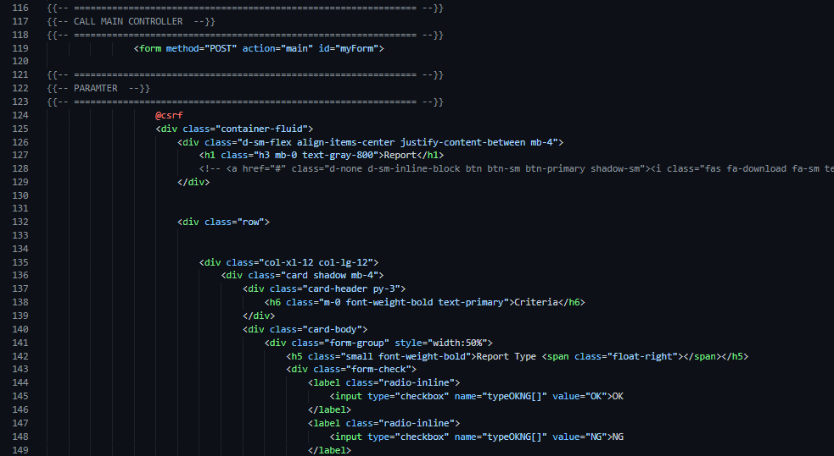
Sample View | Main.blade.php
Adjust data table
Link to main controller
Show data table

Slide 16
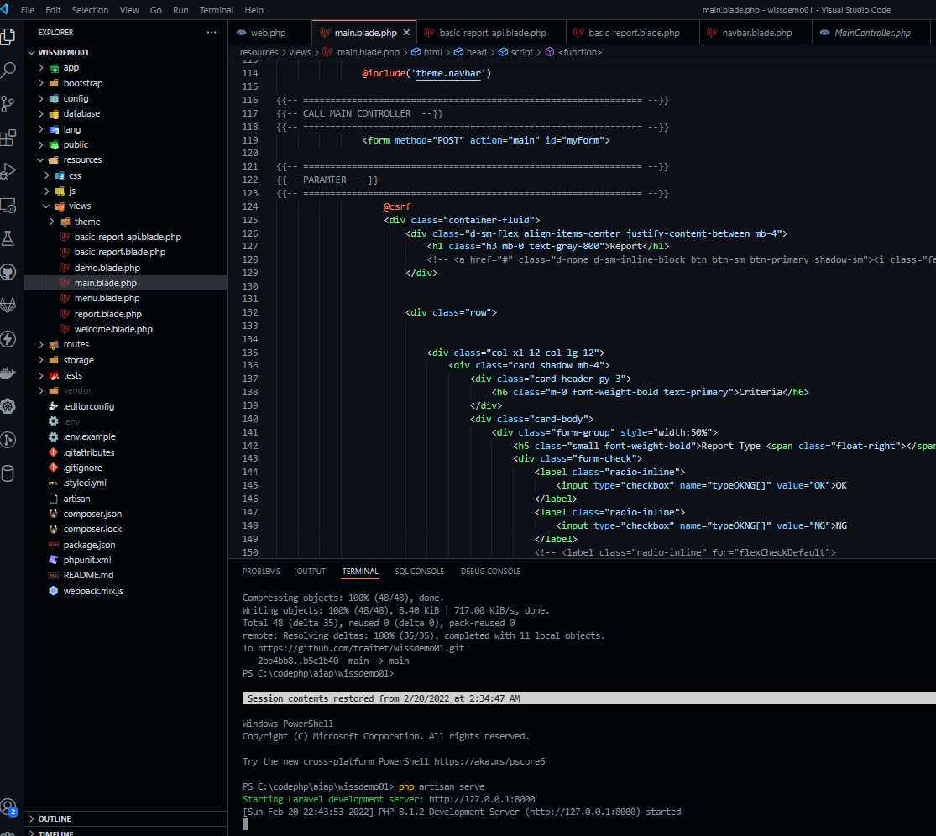
Run service | php artisan serve

Slide 17
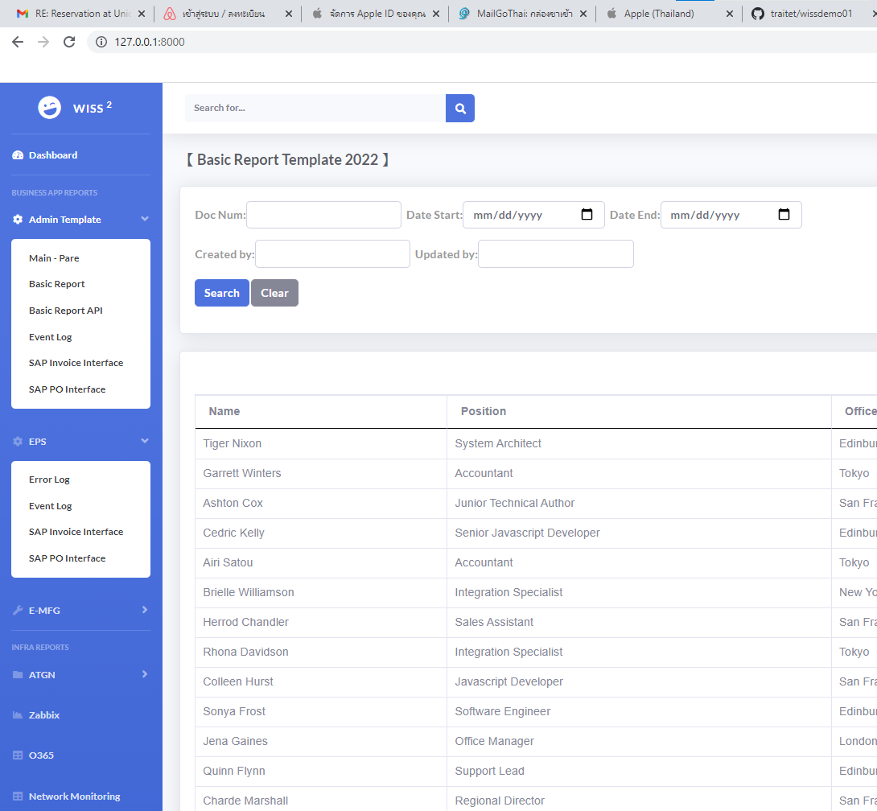
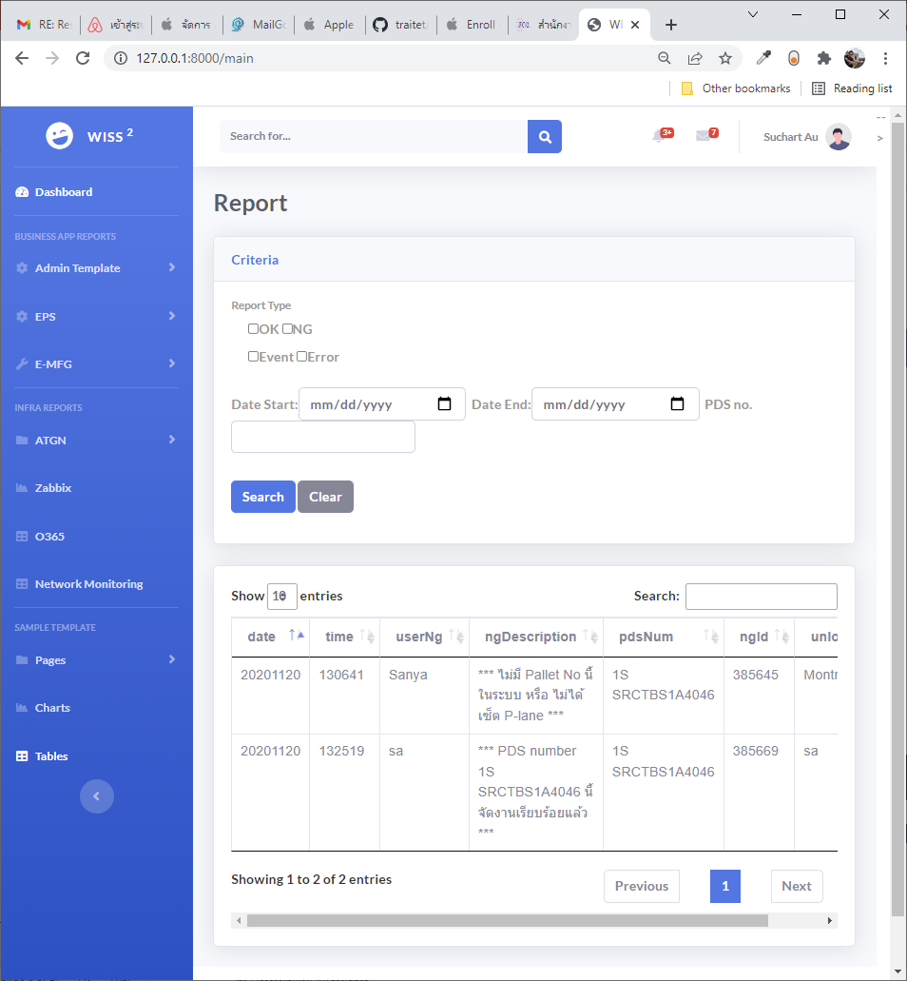
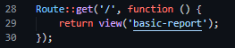
Sample web
Basic Report
Pare’s report
Basic report template
View = /basic-report
Route : return view(‘basic-report’)

Slide 18
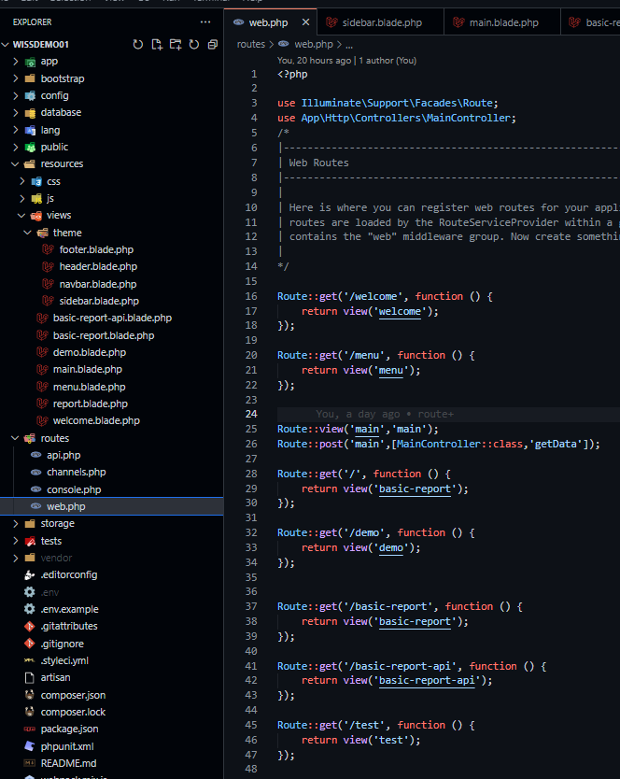
Sample web
Don’t forget to add controller
Main | get and post
Basic Report
Pare’s report
Basic Report
Basic report template
View = /basic-report
Route : return view(‘main’)
Basic report template
View = /basic-report
Route : return view(‘basic-report’)
Route/web.php

Slide 19
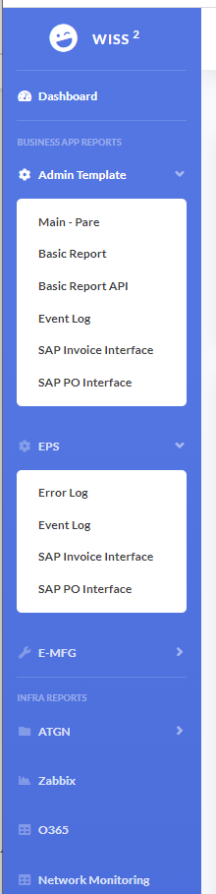
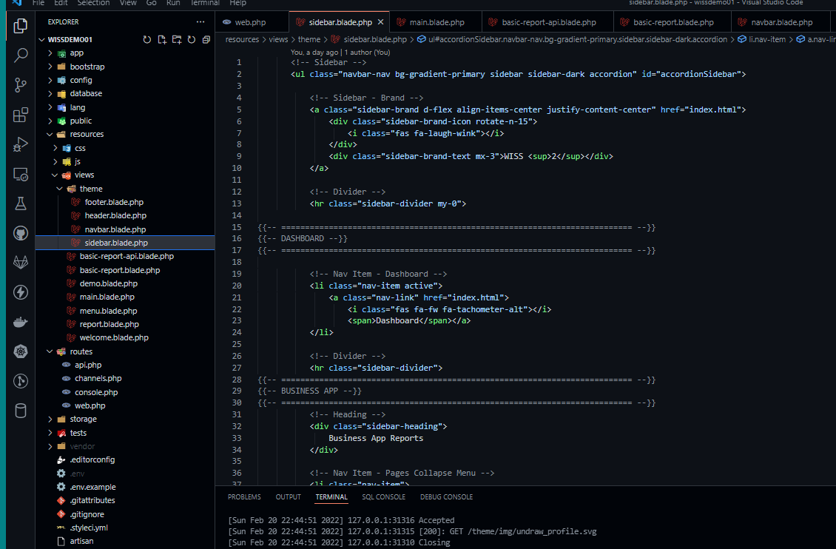
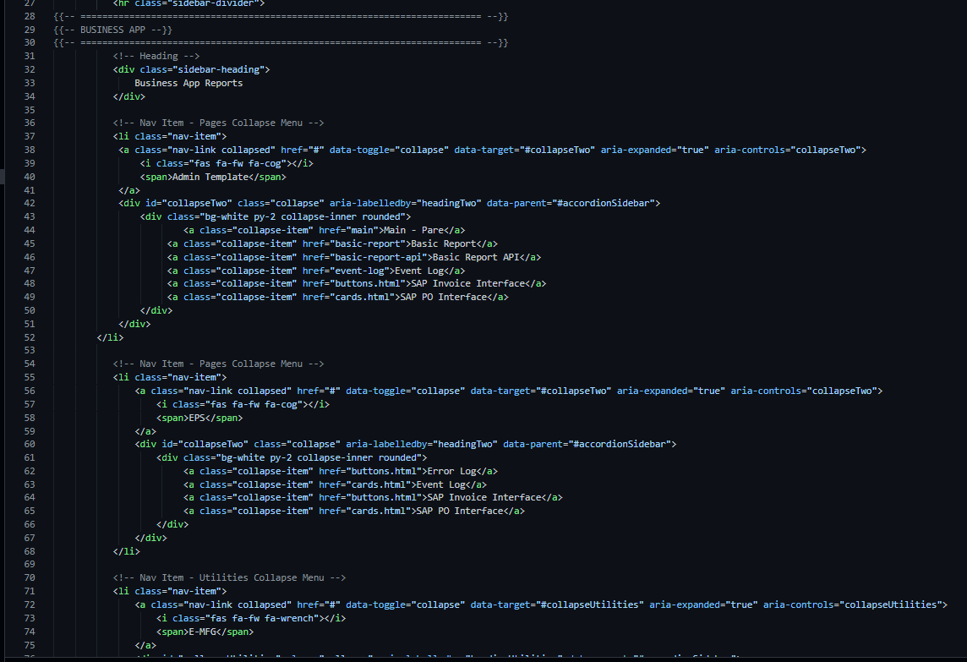
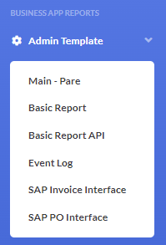
Adjust Navigation Bar

Slide 20
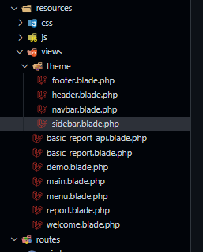





Header, Footer, Nav Bar, Slide Bar
Header
Slide Bar, Nav Bar
Data Table
Fotter
Footer
Slide Bar & Nav Bar
Header

Slide 21



Login, register and forget password

Slide 22


Chart and Table
Table (Data Table)
Chart

Slide 23





Sample
Border
Other
Animate
Color

Slide 24



Sample Component
Button
Card

Slide 25

Dashboard

Slide 26

MVC
Resources/views/flights/show.blade.php
Resources/views/flights/index.blade.php
Resources/views/flights/edit.blade.php
Resources/views/ flights/new.blade.php
App/Models/Flight.php
1. Request URL
Model
View
Database
5. Render view in browser
Model: Data storage, integrity, consistency, queries
Controller: Receive, Interpret & validate input, create & update view, modify model
View: presentation, asset & code (HTML)
4. Controller get Result View
Return View
Controller
Return View
Routing
3. Interact with Data Model
2. Re-route to
correct Laravel Controller
App/Controllers/FlightController.php
routes/web.php
View (get) index, show, edit, new

Slide 27
How to clone git

Slide 28

1. How to clone git
No | Step | Code
1 | Clone git Pull git Required To share git with other: Settings, Collaboration, Add People “git ID or mail” Accept by people added | git clone https:/github.com/traitet/wissdemo01.git git pull
2 | Download package | npm install composer install
3 | Change .env.example to .env
3 | php artisan serve | php artisan serve
4 | Open URL e.g. http://10.100.1.94:8080

Slide 29

Git Hub : add Collaborators

Slide 30
Develop Web API

Slide 31
Web api on Laravel
http://10.100.1.94:8080/wissdemo01/public/api/interface_sap_po http://10.100.1.94:8080/wissdemo01/public/api/interface_sap_po/PO19000483
http://10.100.1.94:8080/wissdemo01/public/api/interface_sap_rec
http://10.100.1.94:8080/wissdemo01/public/api/interface_sap_rec/PO19002270
http://10.100.1.94:8080/wissdemo01/public/api/interface_sap_inv
http://10.100.1.94:8080/wissdemo01/public/api/interface_sap_inv/PO19000483

Slide 32
Web api on Laravel
http://10.100.1.94:8080/wissdemo01/public/api/interface_sap_po
http://10.100.1.94:8080/wissdemo01/public/api/interface_sap_po/PO19000483
http://10.100.1.94:8080/wissdemo01/public/api/interface_sap_rec
http://10.100.1.94:8080/wissdemo01/public/api/interface_sap_rec/PO19002270
http://10.100.1.94:8080/wissdemo01/public/api/interface_sap_inv
http://10.100.1.94:8080/wissdemo01/public/api/interface_sap_inv/PO19000483

Slide 33

http://10.100.1.94:8080/wissdemo01/public/interface-sap-po

Slide 34
steps
Download driver file | https:/medium.com/@anurat/%E0%B9%80%E0%B8%8A%E0%B8%B7%E0%B9%88%E0%B8%AD%E0%B8%A1%E0%B8%95%E0%B9%88%E0%B8%AD-sql-server-%E0%B8%81%E0%B8%B1%E0%B8%9A-laravel-%E0%B8%9A%E0%B8%99-windows-d724aec1ea02
Copy file to php/ext | C:\xampp\php\ext\php_pdo_sqlsrv_81_ts_x64.dll
Add link in Php.ini | extension=php_pdo_sqlsrv_81_ts_x64
Open xamp, phpinfo(), find sqlsrv | http://localhost:8080/dashboard/phpinfo.php
Config .env file | DB_CONNECTION=sqlsrv DB_HOST=10.100.1.47 DB_PORT=49382 DB_DATABASE=SIAM_EPSINFDB DB_USERNAME=wiss01 DB_PASSWORD=wiss01@app
Create controller | php artisan make:controller PhotoController –resource
Add controller code | public function index() { /curl http://10.100.1.94:8080/wissdemo01/public/api/wiss-apis $result = DB::select('select * from TMIFIO'); return json_encode($result); } public function show($id) { if ($id == 'a') {$result = DB::select('select TOP 10 * from TMIFIO');} /curl http://10.100.1.94:8080/wissdemo01/public/api/wiss-apis/a if ($id == 'b') {$result = DB::select('select TOP 10 * from TMIFMAT');} /curl http://10.100.1.94:8080/wissdemo01/public/api/wiss-apis/b if ($id == 'c') {$result = DB::select('select TOP 10 * from TMIFVEN');} /curl http://10.100.1.94:8080/wissdemo01/public/api/wiss-apis/c return json_encode($result); }
Test by curl | Php artisan serve curl http://10.100.1.94:8080/wissdemo01/public/api/wiss-apis/c

Slide 35

/ ================================================================
/ WEB API FROM SIAM_EPSINFDB
/ ================================================================
/ http://10.100.1.94:8080/wissdemo01/public/api/interface_sap_po
Route::get('interface_sap_po', function () {
$result = DB::select("EXEC interface_sap_inv '20190101','20220101','',100");
return json_encode($result);
});
/ http://10.100.1.94:8080/wissdemo01/public/api/interface_sap_po
Route::get('interface_sap_rec', function () {
$result = DB::select("EXEC interface_sap_inv '20190101','20220101','',100");
return json_encode($result);
});
/ http://10.100.1.94:8080/wissdemo01/public/api/interface_sap_inv
Route::get('interface_sap_inv', function () {
$result = DB::select("EXEC interface_sap_inv '20190101','20220101','',100");
return json_encode($result);
});

Slide 36

api.php

Slide 37

1. How to clone git
No | Step | Code
.1 | Run command (Create web api) Add api route | php artisan make:controller PhotoController –resource Route::resource('photos', 'App\Http\Controllers\PhotoController');
2 | Copy code | https:/www.poolsawat.com/laravel-%E0%B8%AA%E0%B8%A3%E0%B9%89%E0%B8%B2%E0%B8%87-restful-api-%E0%B8%87%E0%B9%88%E0%B8%B2%E0%B8%A2-%E0%B9%86-%E0%B8%94%E0%B9%89%E0%B8%A7%E0%B8%A2-resource-routes-controller-ep5/
3 | Run test on terminal | php artisan serve curl http://10.100.1.94:8080/wissdemo01/public/api/photos curl http://10.100.1.94:8080/wissdemo01/public/api/photos/create curl -X POST -H "Content-Type: application/json" -d "{\"name\":\"poolsawat.com\"}" http://10.100.1.94:8080/wissdemo01/public/api/photos curl -X DELETE http://10.100.1.94:8080/wissdemo01/public/api/photos/9999

Slide 38

1. How to clone git
No | Step | Code
.1 | Run command (Create web api) Add api route | php artisan make:controller WissApiController –resource Route::resource('wiss-apis', 'App\Http\Controllers\WissApiController');
2 | Copy code | return response()->json(['name' => 'index']);
3 | Run test on terminal | php artisan serve curl http://10.100.1.94:8080/wissdemo01/public/api/wiss-apis curl http://10.100.1.94:8080/wissdemo01/public/api/wiss-apis/eventlog

Slide 39



.env

Slide 40
.env file | DB_CONNECTION=sqlsrv DB_HOST=10.100.1.47 DB_PORT=49382 DB_DATABASE=SIAM_EPSINFDB DB_USERNAME=wiss01 DB_PASSWORD=wiss01@app
WissApiController.php | $result = DB::select('select * from TMIFIO'); return json_encode($result);
Test command | Php artisan serve curl http://10.100.1.94:8080/wissdemo01/public/api/wiss-apis

Slide 41

Actions Handled by resource controller

Slide 42
Connect SQL server
https:/medium.com/@anurat/%E0%B9%80%E0%B8%8A%E0%B8%B7%E0%B9%88%E0%B8%AD%E0%B8%A1%E0%B8%95%E0%B9%88%E0%B8%AD-sql-server-%E0%B8%81%E0%B8%B1%E0%B8%9A-laravel-%E0%B8%9A%E0%B8%99-windows-d724aec1ea02
Download file e.g. php_sqlsrv_81_ts_x64.dll
Copy to php/ext folder
Add link in php.ini e.g. extension=php_sqlsrv_81_ts_x64
Php artisan serve

Slide 43


Slide 44




10.100.1.94
user: wiss
password: wiss
database DBINFRA
table: emp
query: select * from emp
port: 1433
https:/stackoverflow.com/questions/62955122/how-do-i-connect-laravel-7-to-microsoft-sql-server
curl http://10.100.1.94:8080/wissdemo01/public/api/wiss-apis/b

Slide 45


Slide 46


Slide 47
Appendix
ไม่จำเป็นต้องอ่าน

Slide 48


2. Folder Structure
Controller (http\controllers)
Models
Views
Routes

Slide 49


Sample Command on VScode
1 | composer install
2 | composer create-project --prefer-dist laravel/laravel blog
3 | php artisan serve
4 | php artisan make:migration create_sharks_table --table=sharks –create php artisan make:migration create_contacts_table --table=contacts –create php artisan migrate php artisan make:migration create_users_table php artisan migrate:status php artisan make:factory PostFactory --model=Post composer dump-autoload Php artisan migrate php artisan tinker Post::factory()->count(20)->create() | Create table on Mysql
5 | php artisan make:model Flight php artisan make:model Contact --migration
6 | php artisan make:model Flight –all php artisan make:model Contact –all php artisan make:controller PhotoController –resource php artisan make:controller ContactController –resource Route::apiResource('contacts', 'ContactController’); php artisan config:cache php artisan route:clear
7 | http://localhost:8080/phpmyadmin/ http://localhost:8080/ http://10.100.1.94:8000/ | Xampp – mysql Xampp – web e.g. C:\xampp\htdocs (keep code) Run on Vscode by php artisan serve

Slide 50

Game – CRUD (Create, Read, Update, Delete from DB)

Slide 51


MySQL
Laravel
Database/migration
php artisan make:migration create_sharks_table --table=sharks --create
Database: Laravel
Table: flights
php artisan make:model Flight --all
Table: Laravel

Slide 52

Standard Folders in Laravel
# | Root Folder | Sub Folder | Remark
1 | app | http/Controllers
2 | app | Model
3 | Resources | Views
4 | routes | Web.php Api.php
5 | Public | images
6 | Vendor
7 | Database | migrations | Model → Generate Database
8 | Storage
9 | Bootstrap
10 | config
11
12 | artisan

Slide 53
Routes
Get: Read data from view
Post: Post data from view
Resource
Prefix: Sub URL

Slide 54
Ref Website
Web | For
https:/auth0.com/blog/build-a-laravel-6-app-with-authentication/ https:/www.positronx.io/laravel-contact-form-example-tutorial/ https:/stackoverflow.com/questions/62955122/how-do-i-connect-laravel-7-to-microsoft-sql-server (Laravel connect sql server) https:/seenual.com/laravel-%E0%B8%81%E0%B8%B2%E0%B8%A3%E0%B9%83%E0%B8%8A%E0%B9%89%E0%B8%87%E0%B8%B2%E0%B8%99-routing/ (การช้ route ไทย) | Build a Laravel CRUD App with Authentication

Slide 55

UI Design

Slide 56
Steps to develop PHP Laravel
1. Create route : search,get
2. Create model : input,output
3. Create controller
4. Create route e.g. get, post

Slide 57
Model Structure
reportName | ngLogReport
paramName | type | column name (DB) | Ex
date | string | DATE | 20201003
time | string | TIME | 201603
username | string | USER_NG | Somkid
description | string | NG_DESCRIPTION | *** Kanban 687600D03000 ลูกค้าไม่ถูกต้องกับ Kanban SA 687400210000 ***
pdsNum | string | PDS_NUM | 1G SA11AYHA4660
id | int | NG_ID | 378292
usernameUnlock | string | UNLOCK_NG | Somkid
reportName | okLogReport
date | string | DATE_CHK | 20201125
time | string | TIME_CHK | 085635
pdsNum | string | PDS_NUM | 1B SA11AD1C5079
partNum | string | PART_NUM | 895430K06100
partName | string | PART_NAME | SENSOR SPEED FR LH
partId | string | PART_SA | 2382
qty | int | PACK_QTY | 1
qtyPacked | int | PACKED | 1
username | string | USER_CHK | 4967
reportName | eventLogReport
id | int | ROWID | 18013240
functionName | string | FUNCTION_NAME | Set_User_Logout
description | string | DESCRIPTION | Set User Logout
pdsNum | string | PDSNUM
custPartNum | string | CUSTPARTNUM
createBy | string | CREATEBY | Pornsak
createDate | string | CREATEDATE | 20201120
createTime | string | CREATETIME | 100515
reportName | errorLogReport
id | int | ROWID | 27646
functionName | String | FUNCTION_ID | GET_DATA
message | string | ERROR_MESSAGE | Invalid column name COMPCODE. Invalid column name PLANTCODE. Invalid column name ENABLE. Invalid column name MODULECODE. Invalid column name FEATURECODE. Invalid column name FUNCTIONCODE. Invalid column name MODULECODE. Invalid column name FEATURECODE. Invalid column name FUNCTIONCODE. Invalid column name CONFIGNAME. Invalid column name VALUETXT1. Invalid column name VALUETXT2. Invalid column name VALUETXT3. Invalid column name VALUETXT4. Invalid column name VALUENUM1. Invalid column name VALUENUM2from.
createBy | String | CREATEBY
createDate | String | CREATEDATE | 20201120
createTime | String | CREATETIME | 130257
Input param
String pdsNum
Input param
String pdsNum
Input param
String pdsNum
Input param
String message

Slide 58
SQL script
[OK]
select DATE_CHK, TIME_CHK, PDS_NUM, PART_NUM, PART_NAME, PART_SA, PACK_QTY, PACKED, USER_CHK from TM_LOG_OK where PDS_NUM = '1S SRCTBS1A4046'
[NG]
select [DATE], [TIME], USER_NG, NG_DESCRIPTION, PDS_NUM, NG_ID, UNLOCK_NG from TM_LOG_NG where PDS_NUM = '1S SRCTBS1A4046'
[EVENT]
select ROWID, FUNCTION_NAME, [DESCRIPTION], PDSNUM, CUSTPARTNUM, CREATEBY, CREATEDATE, CREATETIME from TT_EVENT_LOG where PDSNUM = '1S SRCTBS1A4046'
[ERROR]
select * from TT_ERROR_LOG where [ERROR_MESSAGE] like '%1S SRCTBS1A4046%'

Slide 59

ONDE

Slide 60

https:/github.com/coreui/coreui-free-laravel-admin-template.git (Admin Template)
https:/github.com/coreui/coreui-free-laravel-admin-template.git

Slide 61


http://10.100.1.94/WISS-API/ErrorLog/Mockup
http://10.100.1.94/WISS-API/ErrorLog/Mockup | { "id": 27646, "functionName": "GET_DATA", "message": "Invalid column name COMPCODE. Invalid column name PLANTCODE. Invalid column name ENABLE. Invalid column name MODULECODE. Invalid column name FEATURECODE. Invalid column name FUNCTIONCODE. Invalid column name MODULECODE. Invalid column name FEATURECODE. Invalid column name FUNCTIONCODE. Invalid column name CONFIGNAME. Invalid column name VALUETXT1. Invalid column name VALUETXT2. Invalid column name VALUETXT3. Invalid column name VALUETXT4. Invalid column name VALUENUM1. Invalid column name VALUENUM2from.", "createBy": "Nattawut", "createDate": "20201120", "createTime": "130257"}

Slide 62

Compact(‘error’)
Compact(‘error’)

Slide 63
Tutorial – Bootstrap, Awesome Font, Jquery
1 | composer create-project laravel/laravel --prefer-dist laravel8crud
2 | composer require laravel/ui php artisan ui bootstrap php artisan ui bootstrap --auth | Install Bootstrap in Laravel 8 Install Bootstrap Auth Scaffolding Authentication scaffolding generated successfully
3 | npm install && npm run dev
4 | # for node node -v # for npm npm –v npm install npm run watch
5 | http://10.100.1.94:8000/product/1234 http://10.100.1.94:8000/index http://10.100.1.94:8000/game

